Slide 1
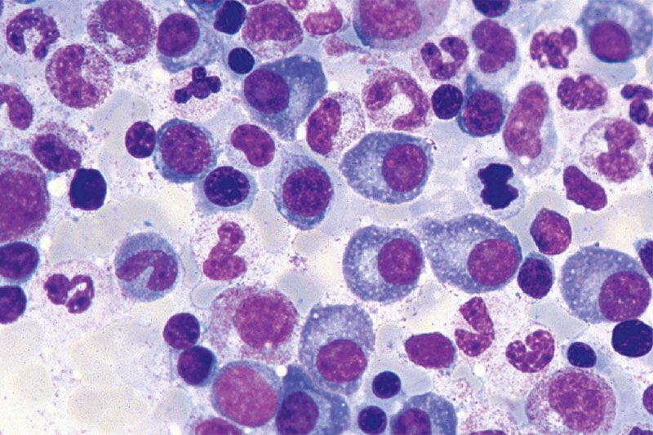
Plasma Cell Disorders
Professor of the Department internal diseases
Liskova Yu.V.

Slide 2
The plasma cell disorders are a group of related diseases that result from a clonal proliferation of plasma cells.
They are usually typified by the presence in the serum or urine of
a monoclonal protein (M-protein) which can be either a complete molecule (paraprotein)
or light chains (Bence Jones protein),
or both.
While each disorder has a distinct diagnostic and clinical phenotype, there is a large degree of overlap between them and hence they are often investigated and clinically managed together.

Slide 3
This group of disorders includes:
Multiple myeloma,
Monoclonal Gammopathy of Undetermined Significance (MGUS),
Primary amyloidosis,
Solitary plasmacytoma,
POEMS (Polyneuropathy, Organomegaly, Endocrinopathy, Monoclonal protein, Skin changes) syndrome,
Waldenström’s macroglobulinemia

Slide 4
Subtypes of Plasma Cell Disorders
Increased Plasma Cells
  Monoclonal Gammopathy
  Myeloma
  Macroglobulinemia (IgM)
Increased / Altered Products of Plasma Cells
  Light Chain Amyloidosis
  Light Chain Deposition Disease

Slide 5
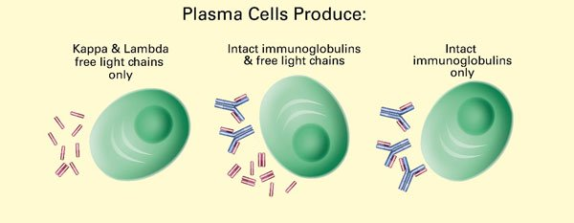
Tumor substrate

Slide 6
B cell Development As a Framework for Malignancies
Lymphoplasmacyte
IgM
Lymph node
Germinal Center
SOMATIC
Lymphoblast
HYPERMUTATION
Plasmablast
SWITCH
RECOMBINATION
Virgin B cell
V(D)J
RECOMBINATION
Bone
Marrow
G,A,E
Plasma cell
Pre-B cell
Notes:
In order to characterize the translocations in MM we need first to determine when they are occuring, during VDJ recombination, or isotype switching. This slide shows a summary of B cell differentiation. In the BM a pre-B cell undergoes VDJ recombination to make a functional Ig gene. An error resulting in a translocation to bcl-1 can result in mantle zone lymphoma, to bcl-2 in indolent lymphoma, and to c-myc to Burkitt’s lymphoma. This cell can enter the bloodstream, and the secondary lymphoid tissue where if it encounters antigen directly as part of the primary immun response, it can differentiate into a short lived plasma cell, that live about 3 days. Alternatively if it encounters antigen in the context of an antigen presenting cell it can enter a germinal center where it undergoes multiple rounds of division and somatic hypermutation of its immunoglobulin genes. The cells who Ig genes have retained or increased their affinity for antigen exit the germinal center, and they may undergo isotype switching and home to the BM where they can differentiate into long lived plasma cells with a lifespan of about 30 days.
It is this cell that is the counterpart of the malignant plasma cell in myeloma. It has switched isotype, and its Ig genes have undergone extensive somatic hypermutation indicaing passage throuh the germinal center. Based on this analysis we postulated that the translocations in MM would occur at this stage, after passing through the germinal, during the process of isotype switch recombination

Slide 7
B cell Development As a Framework for Malignancies
Lymphoplasmacyte
IgM
WALDENSTROM’S
Lymph node
Germinal Center
SOMATIC
Lymphoblast
HYPERMUTATION
Plasmablast
BURKITT’S
LYMPHOMA
FOLLICULAR
LYMPHOMA
Virgin B cell
CLL
Bone
Marrow
MULTIPLE
MYELOMA
G,A,E
Plasma cell
ALL
Pre-B cell
Notes:
In order to characterize the translocations in MM we need first to determine when they are occuring, during VDJ recombination, or isotype switching. This slide shows a summary of B cell differentiation. In the BM a pre-B cell undergoes VDJ recombination to make a functional Ig gene. An error resulting in a translocation to bcl-1 can result in mantle zone lymphoma, to bcl-2 in indolent lymphoma, and to c-myc to Burkitt’s lymphoma. This cell can enter the bloodstream, and the secondary lymphoid tissue where if it encounters antigen directly as part of the primary immun response, it can differentiate into a short lived plasma cell, that live about 3 days. Alternatively if it encounters antigen in the context of an antigen presenting cell it can enter a germinal center where it undergoes multiple rounds of division and somatic hypermutation of its immunoglobulin genes. The cells who Ig genes have retained or increased their affinity for antigen exit the germinal center, and they may undergo isotype switching and home to the BM where they can differentiate into long lived plasma cells with a lifespan of about 30 days.
It is this cell that is the counterpart of the malignant plasma cell in myeloma. It has switched isotype, and its Ig genes have undergone extensive somatic hypermutation indicaing passage throuh the germinal center. Based on this analysis we postulated that the translocations in MM would occur at this stage, after passing through the germinal, during the process of isotype switch recombination

Slide 8
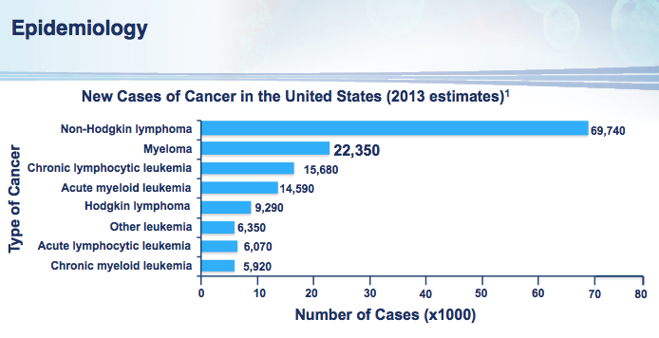

Slide 9
Case Presentation
48 yo Jamaican male
Admitted with 2 wk history of fatigue and diffuse bone pain
Evaluation:
  Increased serum creatinine 5.5 mg/dl (normal < 1.2 mg/dl)
  Increased serum calcium 12 mg/dl (normal < 10.5 mg/dl)
  Increased serum globulin 5.0 g/dl (normal < 3 g/dl)

Slide 10
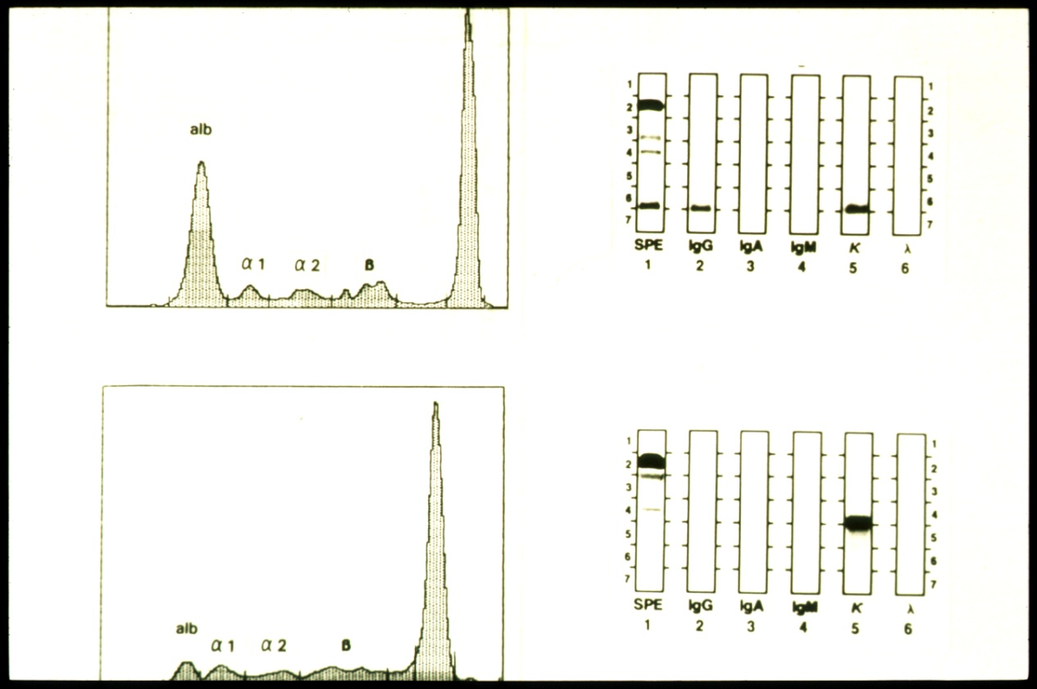
Evaluation of Abnormal Serum Globulins
Serum
Urine
Serum/Urine Protein
Electrophoresis (S/UPEP)
Immunofixation
Electrophoresis (IFE)
Serum M spike 4 g/dl; typed as IgG kappa monoclonal Ig

Slide 11
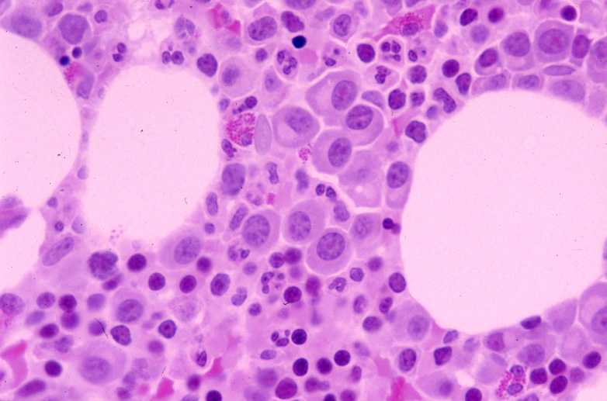
Case Presentation…cont’d
Bone Marrow biopsy - Increased plasma cells

Slide 12
Skeletal survey - Lytic bone disease

Slide 13
Clinical spectrum of clonal expansions of
transformed plasma cells in patients
Stable intramedullary
expansion
Asymptomatic.
MGUS
(premalignant)
Normal
cell
Transformed
Cell
Progressive intramedullary
expansion.
Anemia, bone pain, infections
Lytic bone disease.
Incurable, limited survival.
13000 deaths/yr in USA.
Multiple myeloma
(malignant)

Slide 14
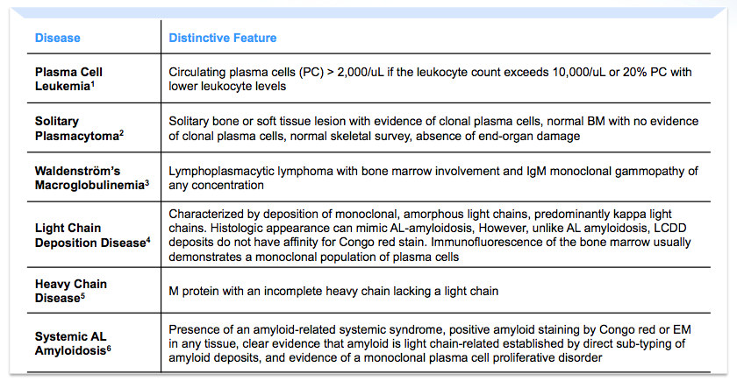

Slide 15
Diagnostic Criteria in Monoclonal Gammopathies
MGUS (Monoclonal gammopathy of undetermined significance)
  < 10% bone marrow plasma cells and M spike < 3 g/dl
  Monoclonal protein / clonal plasma cell population
  No End organ damage
Myeloma
  > 10% marrow plasma cells
  End Organ Damage
Indolent / Smoldering Myeloma
  > 10% marrow plasma cells or M spike > 3 g/dl
  No End organ damage

Slide 16
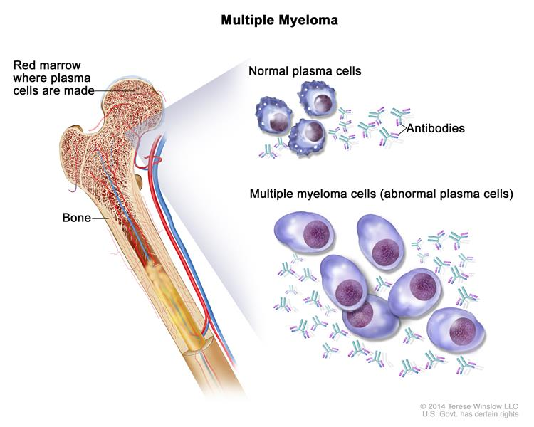
Notes:
Multiple myeloma. Multiple myeloma cells are abnormal plasma cells (a type of white blood cell) that build up in the bone marrow and form tumors in many bones of the body. Normal plasma cells make antibodies to help the body fight infection and disease. As the number of multiple myeloma cells increases, more antibodies are made. This can cause the blood to thicken and keep the bone marrow from making enough healthy blood cells. Multiple myeloma cells also damage and weaken the bone.

Slide 17
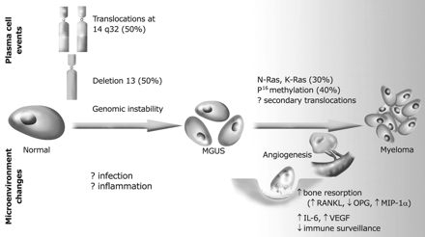
A Model for Pathogenesis of Myeloma

Slide 18
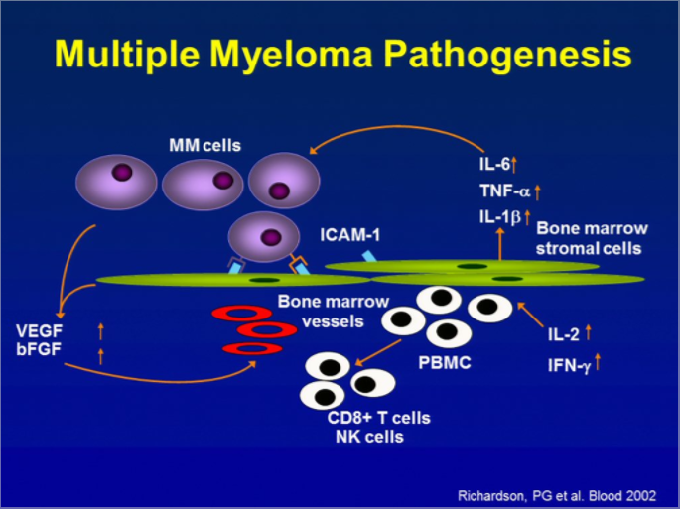

Slide 19
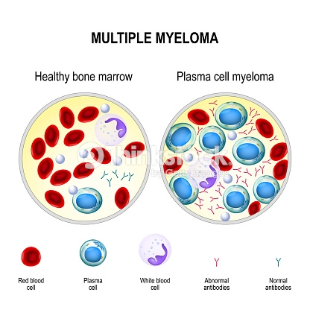

Slide 20
Multiple myeloma (MM) is the second most common haematological malignancy and is characterised by the proliferation of clonal plasma cells in the bone marrow. It is divided into a number of distinct clinical phases.
The first is a pre-malignant stage termed MGUS in which there is a population of clonal plasma cells that produce a monoclonal protein; however, patients are asymptomatic but there is a risk of progressing from MGUS to myeloma.
The next stage is termed asymptomatic myeloma/smouldering myeloma. It has a higher percentage of plasma cells in the bone marrow but still does not cause end organ damage and mostly does not require treatment apart from in high risk patients.
Myeloma requiring treatment, in contrast, causes detectable damage to the bones or kidneys and/or suppression of normal bone marrow function.
Plasma cell leukaemia is the most aggressive stage of disease and is characterised by the presence of plasma cells in the peripheral blood.

Slide 21
Monoclonal Gammopathy of Undetermined Significance (MGUS)
Common, age-related
Prevalence: 3.2% in persons over 50 yrs old (Minnesota)
  ~5% in age >70
Higher prevalence in African populations.
? Association with inflammatory states: obesity, Gaucher’s disease
Increased risk for thrombosis and fractures
Risk of progression in entire population: 1% /yr
Risk factors for progression: % PC, level M spike, Free light chain, IgA protein, ?Decline in uninvolved Ig’s

Slide 22
Smoldering /asymptomatic Myeloma (SMM)
Patients with PC > 10% or M spike > 3 g/dl, but lacking CRAB symptoms.
10% per yr progression to overt MM
Most eventually require therapy.
Current recommendation is observation until progressive disease.

Slide 23
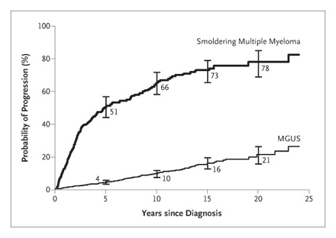
Disease Progression in MGUS and SMM
Kyle et al. NEJM 356: 2582, 2007

Slide 24
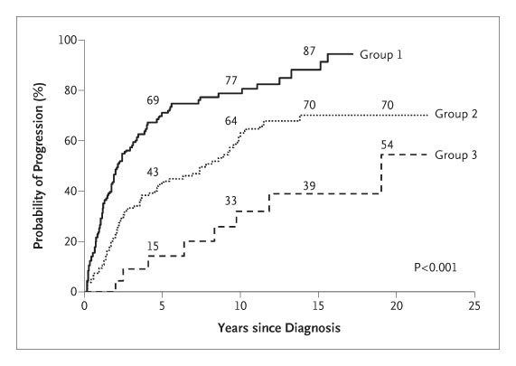
Risk Groups in Asymptomatic Myeloma
G1: BMPC >10% M > 3 g/dl;
G2: BMPC >10% M < 3 g/dl
G3: BMPC <10% M > 3 g/dl
Kyle et al. NEJM 356: 2582, 2007

Slide 25
Multiple myeloma
Uncontrolled proliferation of Ig secreting plasma cells
  most commonly IgG (57%), IgA (21%) or light chain only (18%)
Twice as frequent in men as women, and in blacks as whites
1% of all cancers
  2% in African Americans
Incurable
Median survival 4-6 years
Notes:
Multiple myeloma (MM) is the second most common haematological malignancy and is characterised by the proliferation of clonal plasma cells in the bone marrow. It is divided into a number of distinct clinical phases.

Slide 26
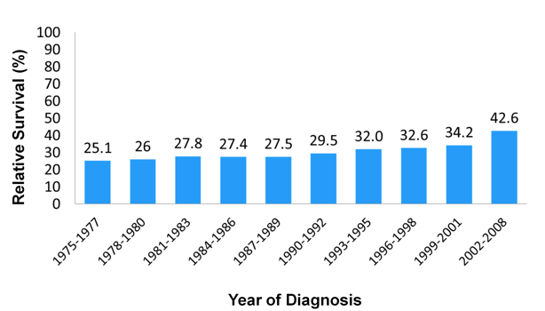
5 year survival (SEER)

Slide 27
Work-up in suspected myeloma
Assessment of serum/urine protein
  SPEP/IF, 24 hr urine for UPEP/IF
  Free light chains (kappa, lambda)
CBC, sCr, Calcium, Albumin, LDH,
Serum beta 2 microglobulin (B2M)
Skeletal survey
Bone marrow aspirate and biopsy
  Cytogenetics (including FISH)
Under investigation:
  MRI spine
  PET scans
  Bone densitometry, Urine n-telopeptide

Slide 28
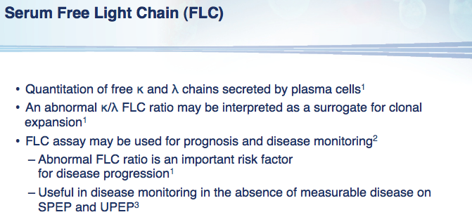
* Kappa and Lambda FLC’s are both increased in renal failure/CKD

Slide 29
Key clinical aspects of myeloma
Predominantly intra-medullary growth.
Absence of clinical LN or spleen involvement.
Low proliferative fraction.
Long periods of stability in MGUS.
Osteoclast activation, osteoblast inhibition, and bone loss.
Multi-focal growth of tumor cells.

Slide 30
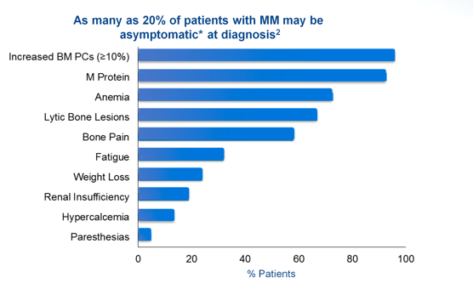
Clinical presentation

Slide 31
Manifestations of Clonal Plasma Cell Proliferation
Osteoclast
Osteoblast
LYTIC BONE DZ
HYPERCALCEMIA
Ig deposition
Cast nephropathy
RENAL FAILURE
Immune-paresis
Hypogamm
INFECTION
Erythropoiesis
ANEMIA

Slide 32
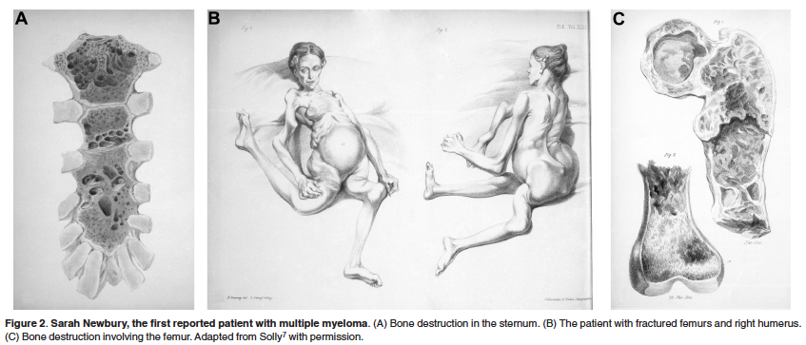
Historical aside…
At age 39, developed fatigue and bone pain from several fractures. She died 4 years later; autopsy showed that her marrow was replaced by a red, gelatinous substance

Slide 33
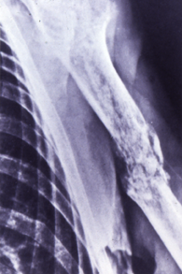
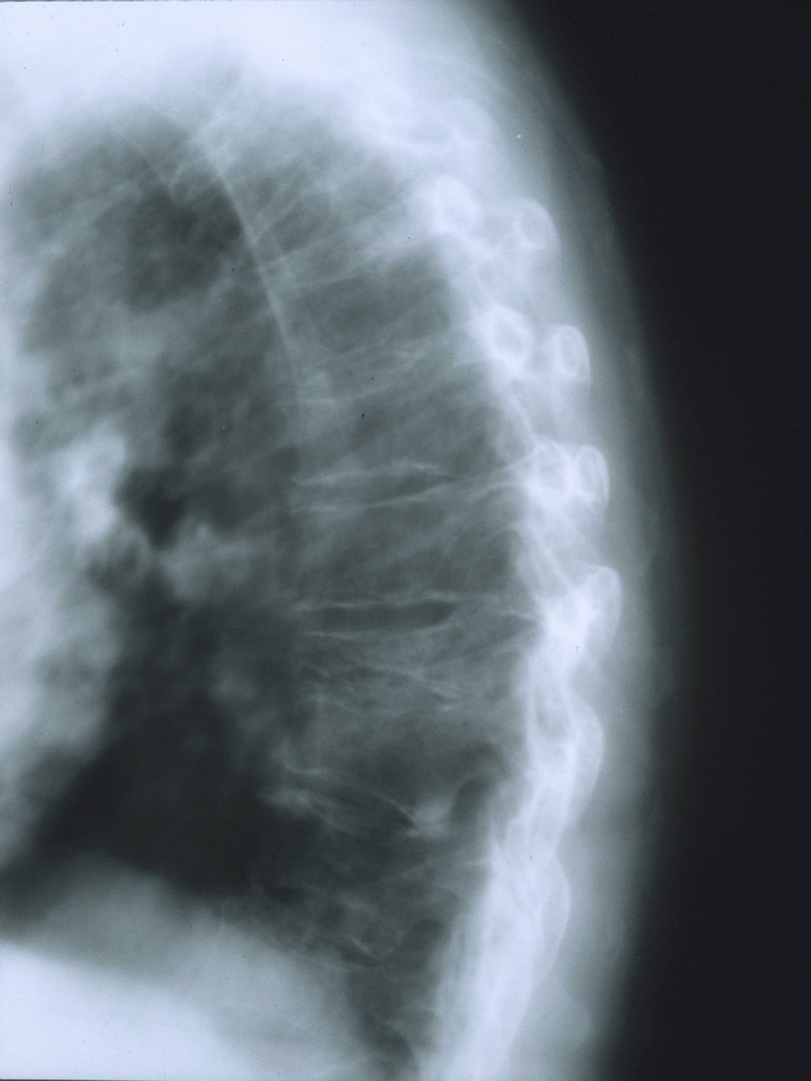
Multiple Myeloma: Skeletal Complications
Notes:
Examples of fractures and spinal cord compression in multiple
myeloma patients.
Bone pain is the most frequent symptom at presentation; 68%-80% of
patients present with destructive osteolytic lesions at time of diagnosis.
Sheridan CA, Serrano M: Multiple myeloma, in Yarbro CH, Frogge MH, Goodman M et al (eds). Cancer Nursing: Principles and Practice (5th ed) Jones and Bartlett, Boston, pp 1354-1370; Sheridan CA et al. Semin Oncol Nurs. 1996;12:1-12; Wilkes GM, Ingwersen K, Barton-Burke M. 2003 Oncology Nursing Drug Handbook, Boston, Jones and Bartlett. 2003; Tariman J et al. Clin J Oncol Nurs. 2003;7:143-147; Annas GJ et al. Am J Pub Health. 1999;89:98-101; van de Poel, Pasman Schoutnen et al. Netherlands J Med. 2001;59:45-49.

Slide 34
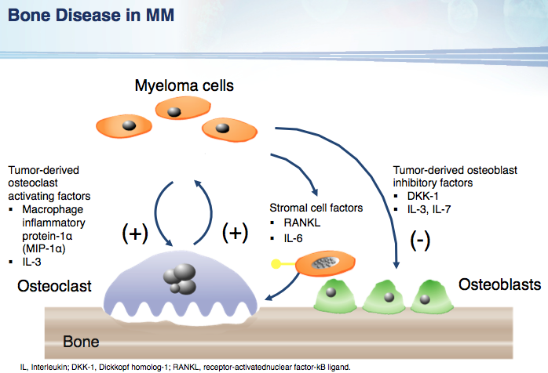

Slide 35
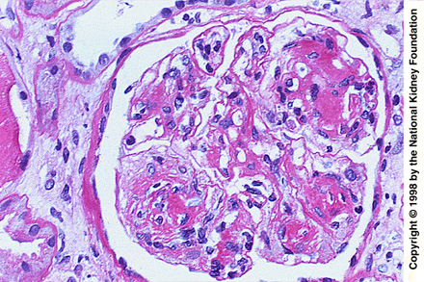
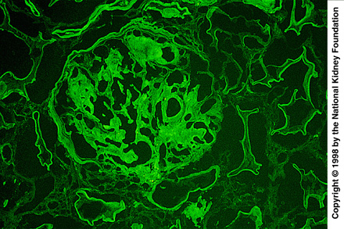
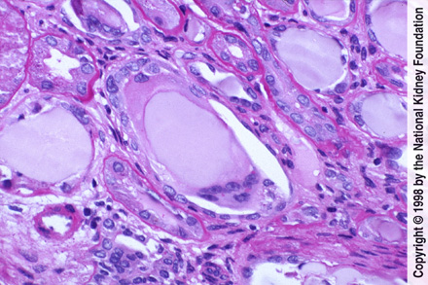
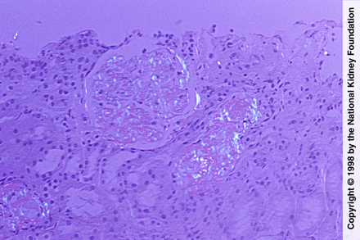
Renal Pathology in MM
Light Chain Deposition Disease
Light Chain Cast Nephropathy
AL Amyloid
Notes:
Fig 1. The characteristic appearance of light chain deposition disease by light microscopy is that of a nodular glomerulosclerosis, which strongly resembles diabetic nephropathy, as in this case (periodic acid-Schiff stain; original magnification x400).
Fig 5. Glomerular capillary loop, mesangial staining, and linear tubular staining are characteristic of light chain deposition disease. Either kappa or lambda light chain paraprotein may cause light chain deposition disease, although kappa more commonly is the culprit (antibody to kappa light chain, immunofluorescence; original magnification x200).
Fig 3. Close-up of intratubular refractile casts with surrounding syncytial giant cell reaction with chronic tubulointerstitial nephritis and fibrosis, characteristic of myeloma cast nephropathy (PAS stain; original magnification x400).
Fig 7. When the Congo red stain is viewed under polarized light, areas of amyloid show apple green birefringence. In this case, amyloid deposits are seen in the mesangial areas, the capillary loops, and in vessels (Congo red stain; original magnification x100).

Slide 36
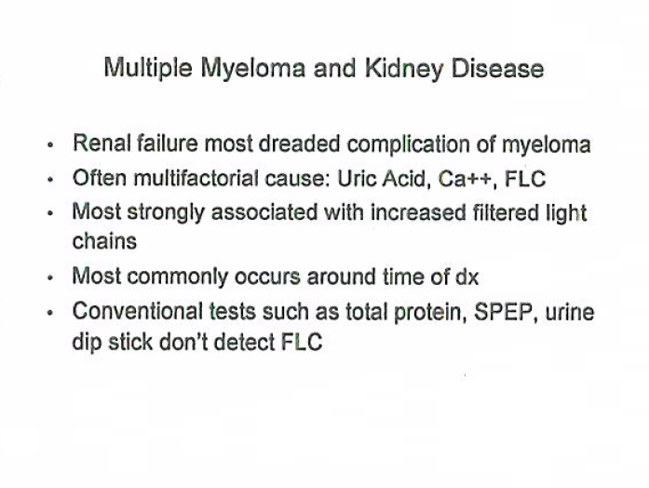

Slide 37
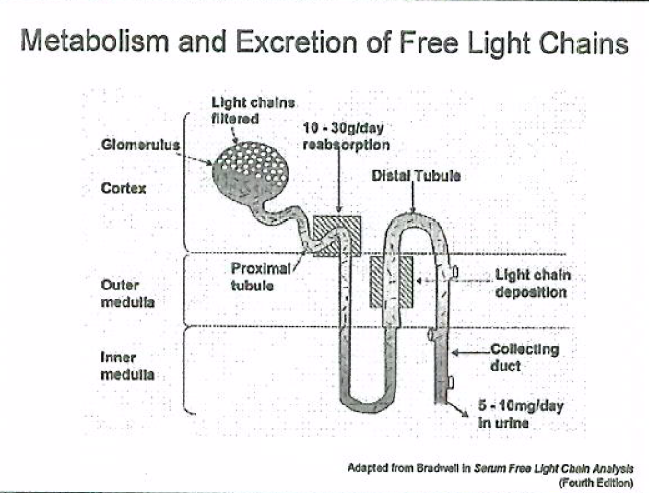

Slide 38
Diagnosing Myeloma
Lab results
    CBC and chemistry panel
    Protein evaluation (blood and urine)
    Immunoglobulin (antibodies) levels- IgG, IgA, IgM
Imaging
    Bone lesions: X-ray (bone survey), CT, MRI, PET
Pathology
    Bone marrow biopsy and cytogenetics

Slide 39
Monoclonal Protein
Present in majority of patients and 97% have a monoclonal or M protein
    Made by non-functioning plasma cell seen in serum and/or 24 hour urine. Termed paraprotein
Testing- serum protein electropheresis (SPEP) or urine protein electopheresis (UPEP)
No detectable protein in 3% (non-secretory)

Slide 40
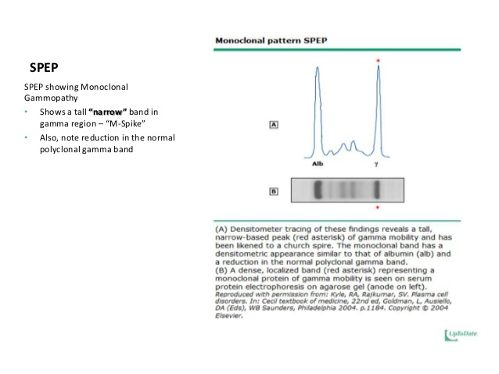
Monoclonal Protein
Immunofixation (IFE) identifies the heavy and light chain components
Protein elecrophoresis (PEP) quantifies the protein

Slide 41
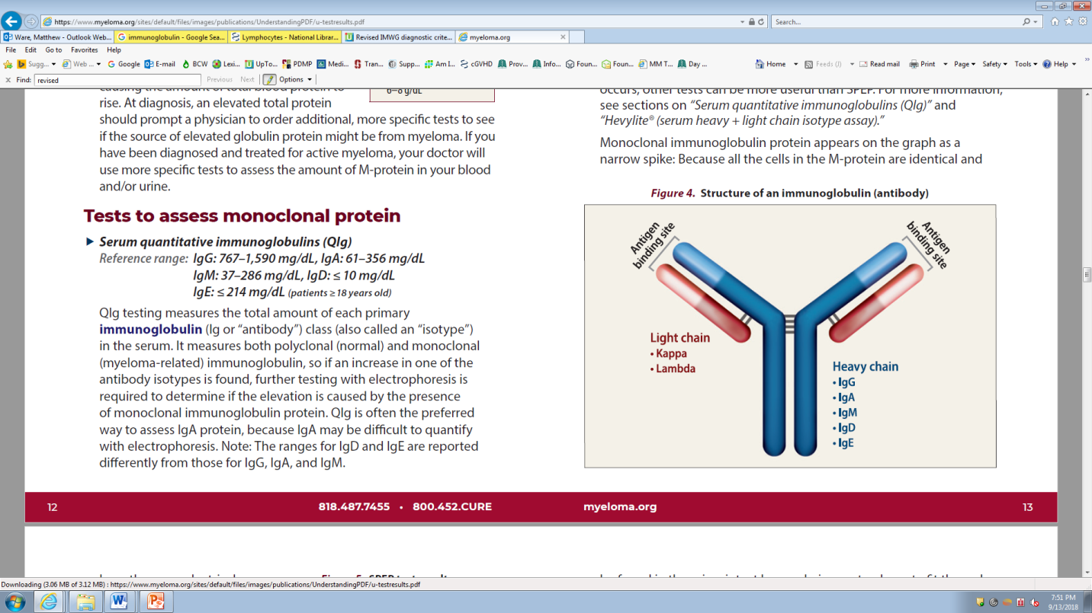
Immunoglobulin
IMF, 2018

Slide 42
Monoclonal Protein
IgG- 52%
IgA- 21%
Kappa or lambda chain only (Bence Jones)- 16%
IgD- 2%
Biclonal- 2%
IgM- 0.5%
Negative- 6.5%

Slide 43
Free Light Chains (FLC)
Measures Kappa and Lambda not bound to heavy chains.
  Normal ratio Kappa:Lambda is 2:1 for intact proteins and 0.26 to 1.65 when measuring those unbound to heavy chains in the blood
  Ratio over 100, there was a 70-80% chance of end organ damage in 2 years

Slide 44
Serum Immunoglobulins
IgG, IgA, IgM
Reduction in uninvolved immunoglobulins
  90% to have reduction in one
  70% to have both reduced

Slide 45
Bone Marrow Biopsy
Percentage of plasma cells- Normal range is 1-2%
Morphology- mature, immature, atypical
    Mature is better prognosis
Can derive kappa/lambda ratio from here or serum
Cytogenetics- Chromosomal abnormalities

Slide 46
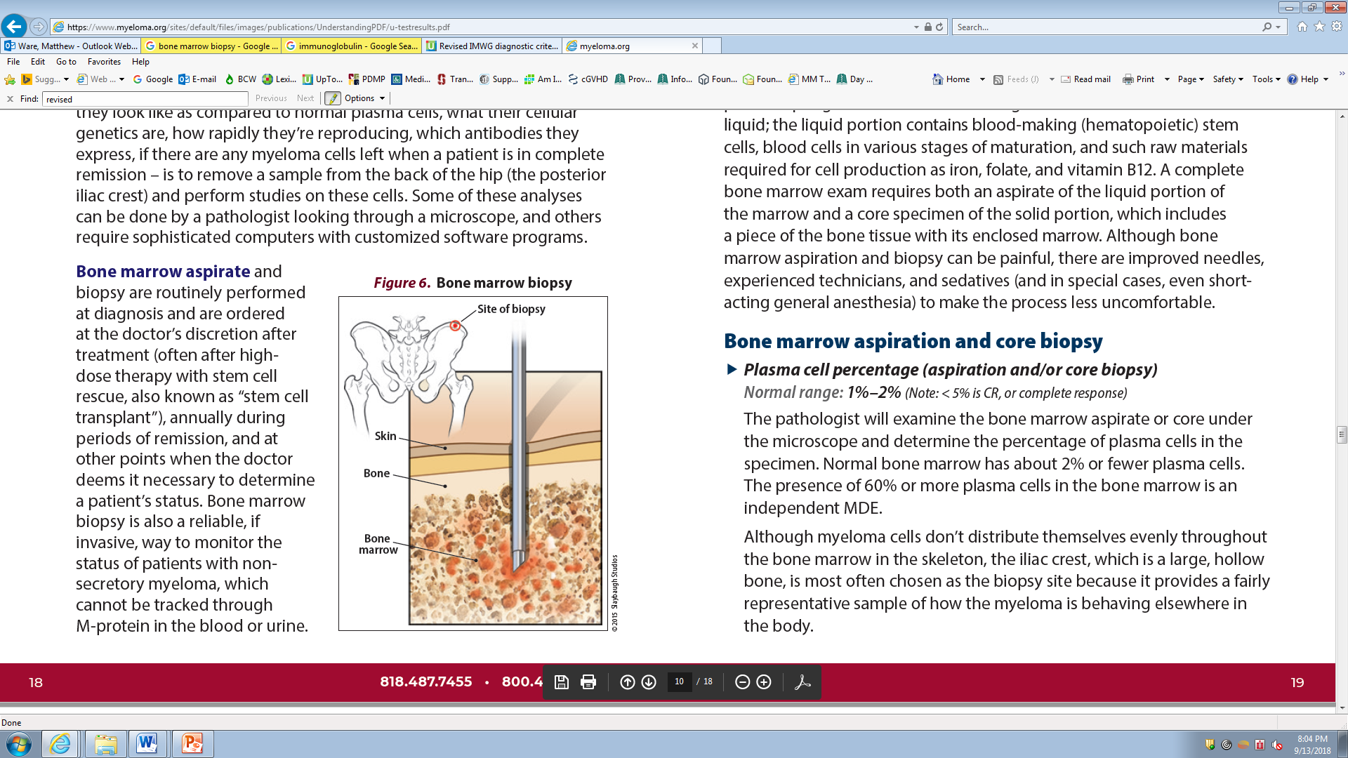
Bone Marrow Biopsy
IMF, 2018

Slide 47
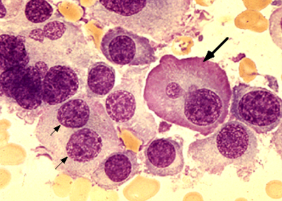

Slide 48
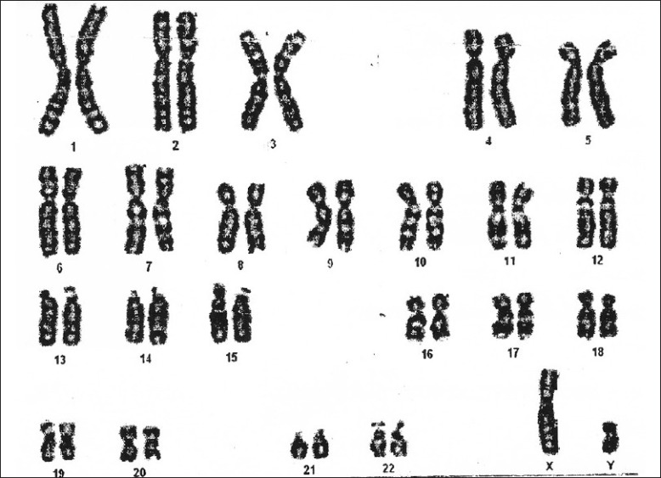
Bone Marrow- Cytogenetics
Chromosome abnormalities
Conventional karyotype is 20-30%
  -Number and appearance of chromosomes gains, loses of chromosomes or deletions. Seen in dividing cells (1-3% of the plasma cells)
G, 2018

Slide 49
Bone Marrow- FISH
Fluorescent in situ hybridization (FISH)- Fluorescent labeled DNA sequences that find a complement on the plasma cells
Detects changes regardless of plasma cells growth
Chromosome- Long (q) and short (p) arm make up a chromatid

Slide 50
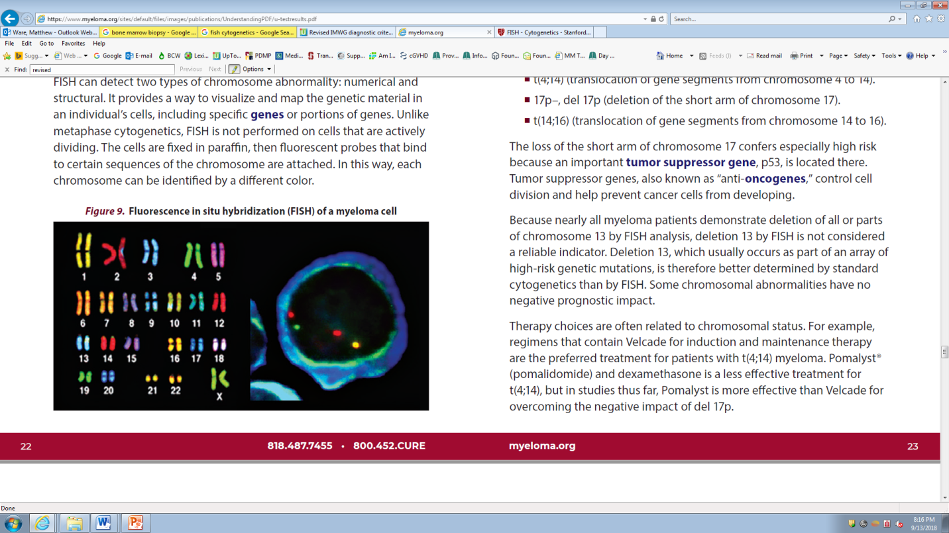
Bone Marrow- FISH
IMF, 2018

Slide 51
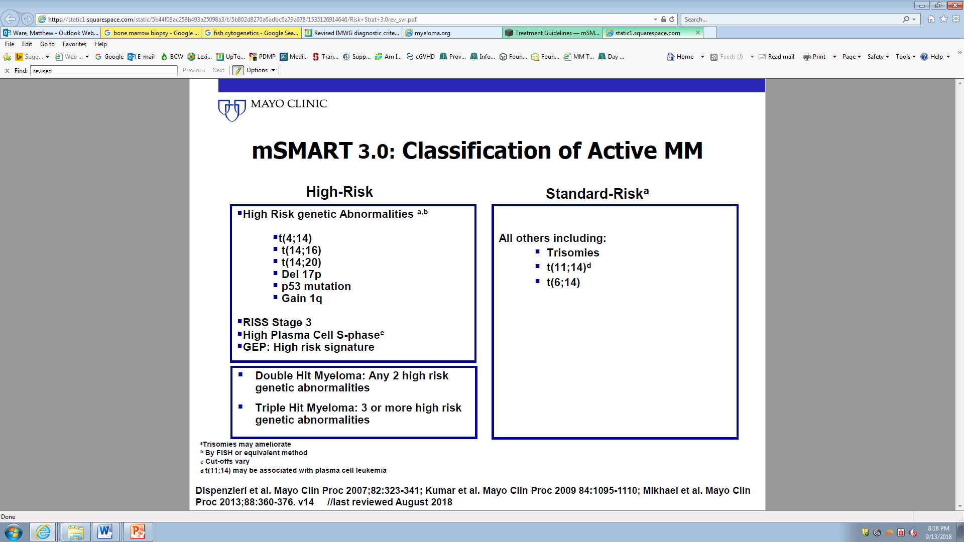
Cytogenetics and FISH

Slide 52
Criteria for End-Organ Damage in Monoclonal Gammopathies
CRAB
  Calcium > 1 mg/dl above ULN
  Renal Insufficiency (> 2 mg/dl)
  Anemia (< 10 g/dl)
  Bone Lesions (lytic lesions or osteopenia)

Slide 53
CRAB
Calcium (elevated)- Hypercalcemia
    Results from bone break down
    Symptoms of nausea, constipation, poor appetite, confusion, thirst
    Seen in 28% of patients on presentation

Slide 54
CRAB
Renal (kidney) Failure or Dysfunction
    Creatinine is a waste product from normal muscle breakdown, filtered by kidneys and excreted
    Increased by monoclonal proteins and high calcium
    Symptoms of confusion, weakness, nausea, fatigue, fluid retention, decreased urine output
    Elevated creatinine in 48% on presentation

Slide 55
CRAB
Anemia
    Lower red blood cells (hemoglobin)
    Marrow replaced by cancer cells
    Present with fatigue, weakness, lightheadedness, slowed thinking
    Seen in 73% patients on diagnosis

Slide 56
CRAB
Bone Lesions
    Pain, commonly seen in ribs and spinal cord
    Bone breakdown can lead to fractures (broken bones), which release calcium into the bloodstream (hypercalcemia)
    Compression fractures
    Seen in 58% on presentation

Slide 57
Imaging
X-ray or bone survey
CT
MRI
PET

Slide 58
X-ray or Bone (skeletal) survey
Thinning of bone or lytic lesions (holes in bone) and/or fractures
Limitation: 30% or more of trabecular (cancellous or spongy) bone must be missing to be seen on x-ray and 50-75% from lumbar vertebra before visible
Appearance may not change following therapy
Not best for determining cause of pain
Not sensitive for focal lesions in bone marrow

Slide 59
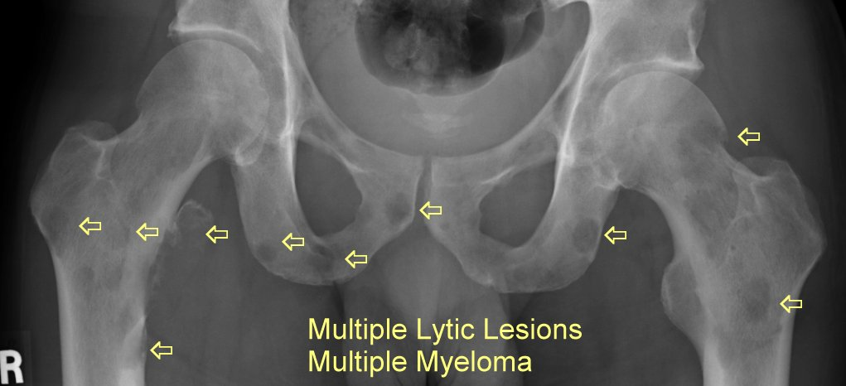
X-ray
AC, 2018

Slide 60
CT (Computed [axial] Tomography)
Cross sectional x-ray
Detection in up to 25% of those with negative x-ray
Soft tissue masses seen compared to x-ray
Quicker than x-ray
Not as sensitive as MRI in detecting lesions outside bone marrow
Contrast
More expensive than x-ray

Slide 61
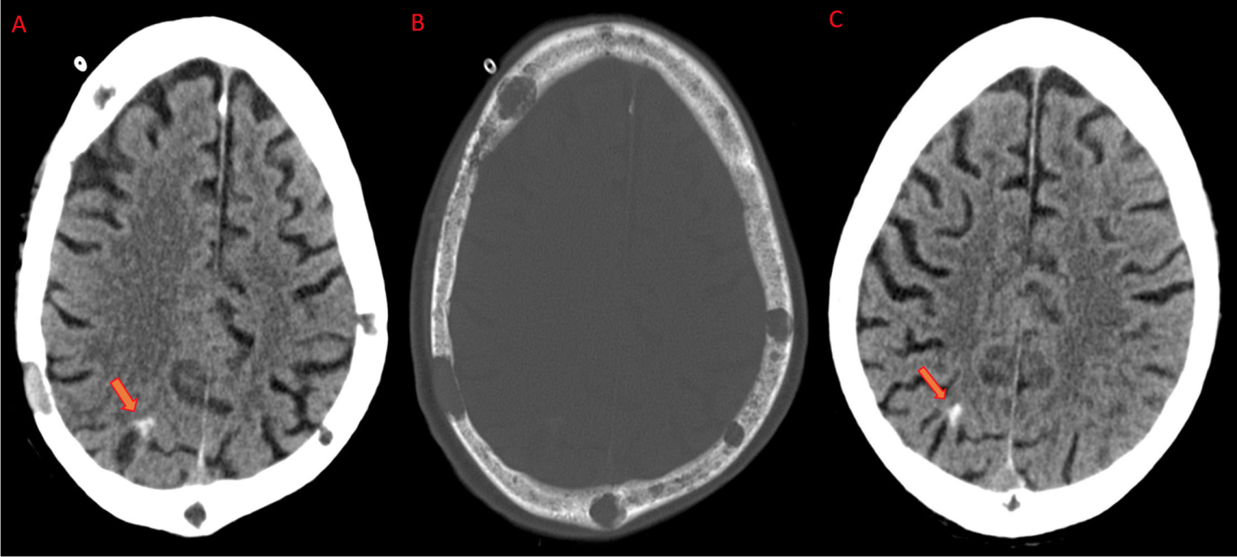
CT
AC, 2018

Slide 62
MRI (Magnetic Resonance Imaging)
Picks up bone marrow involvement
Preferred for spinal cord assessment (compression)
Osteoporosis vs vertebral fractures
52% had normal x-rays
Limitations: expensive, time consuming, implants (metal), pacemakers, claustrophobia, contrast and kidney function
9 month lag time of active disease

Slide 63
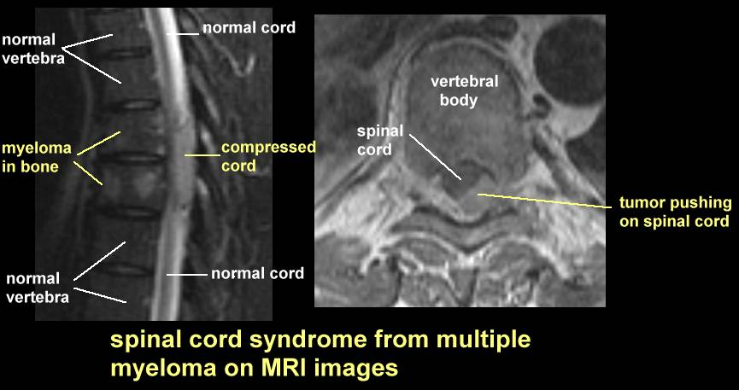
MRI
AC, 2018

Slide 64
PET (Positron Emission Tomography)
Radiolabeled glucose, uptake taken by cancer cells (actively dividing), muscle and brain
FDG- fluorodeoxyglucose
Find a mass where there is no bone lesion
Extramedullary disease (Non-secretory)
Three or more lesions poorer OS and PFS
Expensive
Inflammation
Skull lesions missed due to FDG avidity of brain
Medicare covers 1 PET scan
  May cover additional during relapse, non-secretory additional malignancy

Slide 65
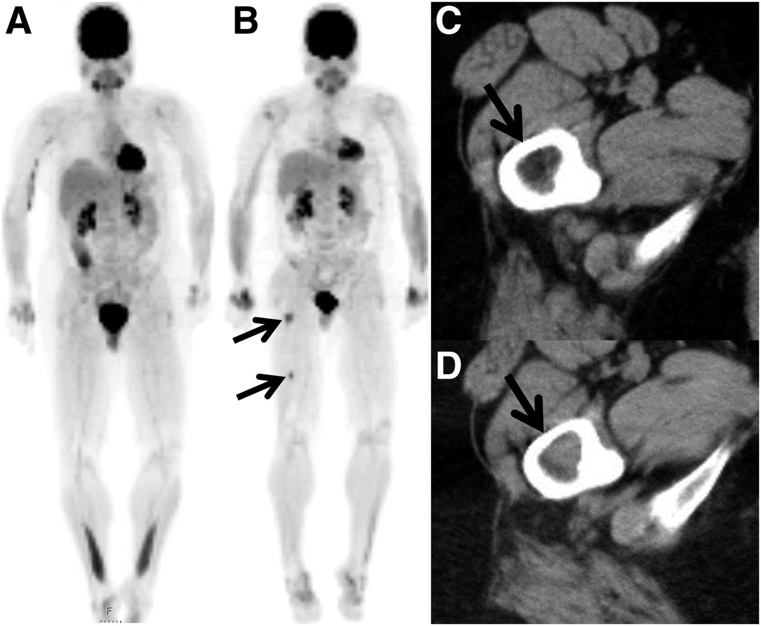
PET
AC, 2018

Slide 66
Additional Labs
Beta-2 microglobulin- (B2M) is a protein on the cell surface of most cells. Shed into bloodstream. Commonly seen on B lymphocytes and tumor
Total protein- albumin and globulin. M-protein increases blood globulin
Albumin- Most abundant protein in blood plasma
LDH (Lactate dehydrogenase)- enzyme in almost every cell and involved in fueling cells. Seen when cells are rapidly dividing and dying

Slide 67
RISS (Revised International Staging System)
Based on blood work
Amount of albumin
Beta-2 microglobulin
LDH
Cytogenetics (bone marrow)
3 stages

Slide 68
RISS- Stages
Stage I
    Beta-2 microglobulin < 3.5 mg/L AND Albumin is 3.5 g/dL or greater AND standard cytogenetics AND normal LDH levels
Stage II
    Not stage I or III
Stage III
    Beta-2 microglobulin > 5.4 mg/L AND high risk cytogenetics AND/OR LDH high (2 times upper limit of normal)
Median overall survival (OS) for patients with ISS stages I, II, and III were 62, 44, and 29 months, respectively.

Slide 69
Diagnostic Criteria
Diagnostic criteria for symptomatic multiple myeloma
Monoclonal plasma cells in bone marrow (aspirate or trephine) ≥10%
Serum paraprotein ≥30g/L (if IgM paraprotein exclude lymphoplasmacytic lymphoma)
Evidence of end organ damage that can be attributed to myeloma. This is termed myeloma-related organ or tissue injury (ROTI) and commonly called the CRAB criteria:
C: hypercalcaemia (corrected Ca2+>0.25mmol/L above normal or >2.75mmol/L)
R: renal impairment (no other cause)
A: anaemia (Hb <100g/L or <20g below normal) not due to other causes
B: bone lesions (lytic lesions or osteoporosis).

Slide 70
Diagnostic Criteria
Diagnostic criteria for smouldering asymptomatic myeloma
Monoclonal serum protein of >30 g/L and/or
10–60% or more clonal plasma cells in bone marrow
Absence of end organ damage defined by CRAB or IMWG defined biomarkers of malignancy.

Slide 71
Diagnostic Criteria
Diagnostic criteria for monoclonal gammopathy of undetermined significance (MGUS)
Paraprotein <30 g/L and marrow clonal plasma cells <10% and lymphoplasmacytic lymphocytes <10%
No evidence of myeloma related organ or tissue impairment
No evidence of other B cell proliferative disorder or amyloid
Urinary monoclonal protein <500mg/24h.

Slide 72
Diagnostic Criteria
Diagnostic criteria for solitary plasmacytoma of bone
A single bone lytic lesion confirmed to be composed of clonal plasma cells on biopsy
Absence of a clonal plasma cell bone marrow infiltrate using aspirate, trephine and/or flow cytometry (Note clonal plasma cell infiltrate <10% is classified as solitary plasmacytoma with minimal marrow involvement)
Presence or absence of monoclonal serum or urine protein
Absence of evidence of plasma cell related organ or tissue injury.

Slide 73
Diagnostic Criteria
Diagnostic criteria for monoclonal deposition disease, including amyloidosis and light chain deposition disease
Biopsy-proven evidence of interstitial protein deposition on tissue biopsy (e.g. amyloid by congo red stain on rectal biopsy, light chains on renal biopsy by immunohistochemistry or electron microscopy)
Absence of significant bone marrow plasma cell infiltrate (<10%)
Absence or presence of monoclonal serum or urine protein (if amyloid is present it is important to distinguish whether patients also have myeloma; if myeloma is present then patients should be treated according to this pathway).

Slide 74
Diagnostic criteria for WM
There are no uniform diagnostic criteria but the most widely used are:
BM infiltration with small lymphocytes, plasmacytoid cells and plasma cells accounting for > 30% of nucleated cells, with the following immunophenotype: sIg+ (5:1 κ:λ ratio) CD19+ CD20+ CD23- CD5- CD10.
Presence of monoclonal IgM > 30 g/L. (IgG, IgA and non-secretory WM accounts for <5% of cases).
Immunophenotype of WM: B cell associated antigens: CD19, CD20, CD22, CD79A. Surface and/or cytoplasmic Ig (usually IgM). CD5 is expressed in 5–20% of cases. CD23 may be expressed in 10–35% of cases.
Genetic characteristics of WM:
The commonest cytogenetic abnormality (>50% of cases) is 6q21 (BLIMP-1)-. Other abnormalities that have been described include trisomy of chromosomes 4, 5 or 8 and 20q-.
MYD88 (L265P) is a commonly recurring mutation found in >90% of LPL. Allele-specific PCR may be useful for differentiating WM from other lymphoid neoplasms in difficult cases.
CXCR4 mutation is present in 30% of patients.
17p13 (TP53) deletion or 14q32 (IGH) translocations in <10% of patients and are associated with shorter progression-free survival.
Absence of lytic lesions and mature plasma cell infiltration to distinguish WM from IgM myeloma.

Slide 75
Principles Of Treatment
No evidence (yet) that early treatment prolongs survival
Wait for symptoms, or evidence of disease progression, to start treatment
Supportive measures are critically important
  drink plenty of fluids daily
  treat infections promptly
  prophylactic bisphosphonates reduce skeletal complications in patients with osteopenia and lytic bone disease
  anemia often responds to erythropoietin.

Slide 76
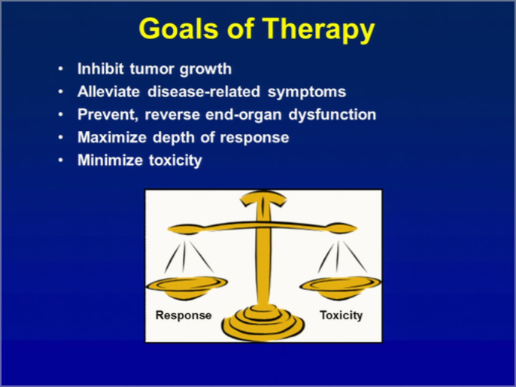
“Myeloma treatment is a marathon, not a sprint”

Slide 77
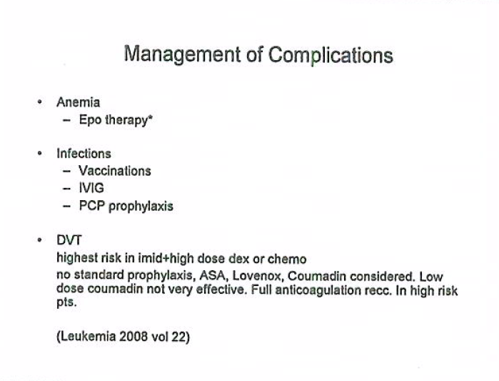

Slide 78
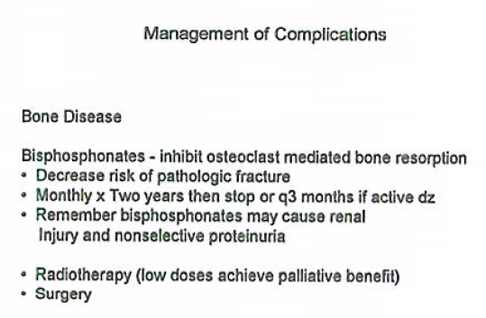

Slide 79
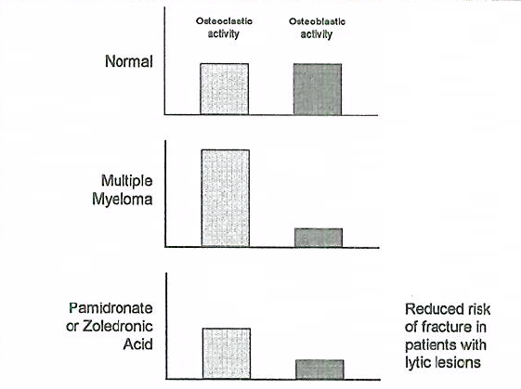

Slide 80
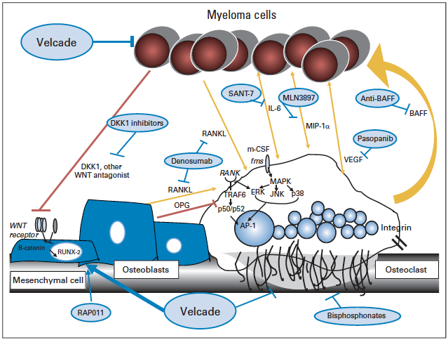
JCO, 30(4), Feb 2012

Slide 81
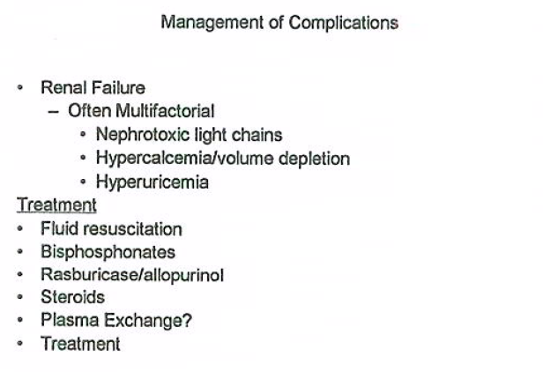

Slide 82
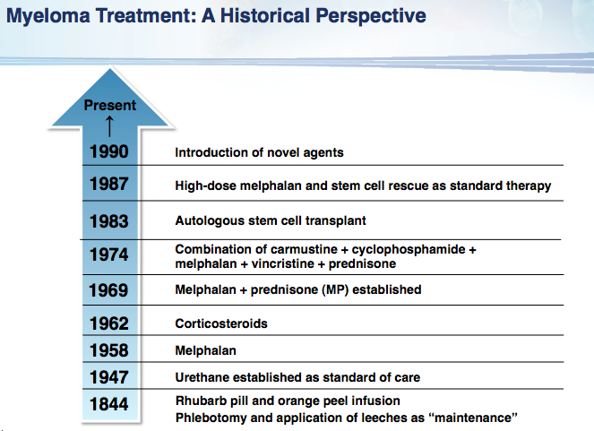

Slide 83
Major drugs in myeloma
Alkylators - 1962
  Melphalan, cyclophosphamide
  High dose melphalan and ASCT
Glucocorticoids - 1966
  Prednisone, dexamethasone
IMiDs - 1999
  Thalidomide
  Revlimid
  Pomalidomide
Proteasome Inhibitors - 2001
  Bortezomib
  Carfilzomib

Slide 84
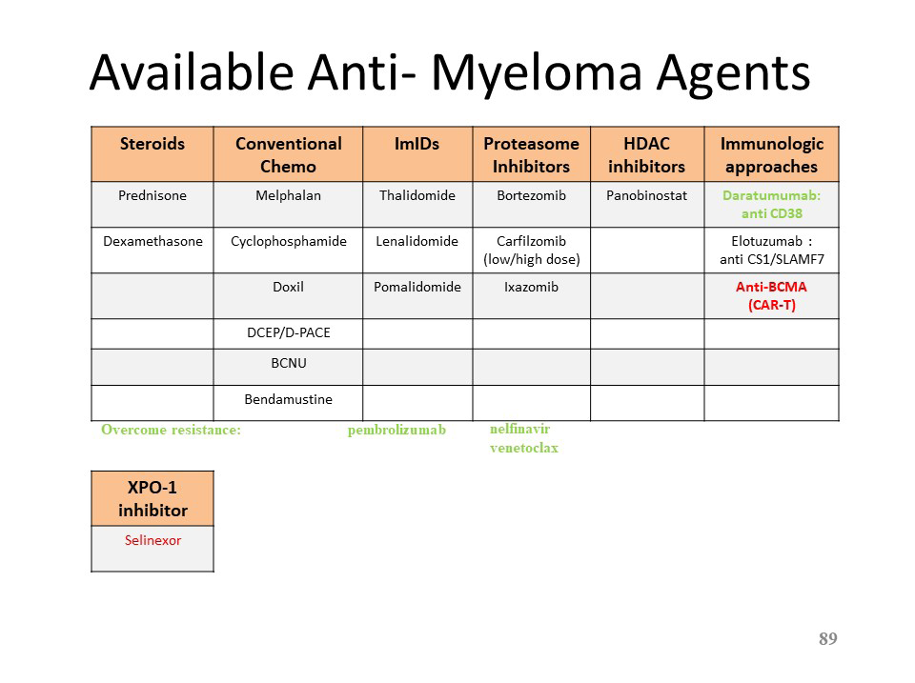

Slide 85
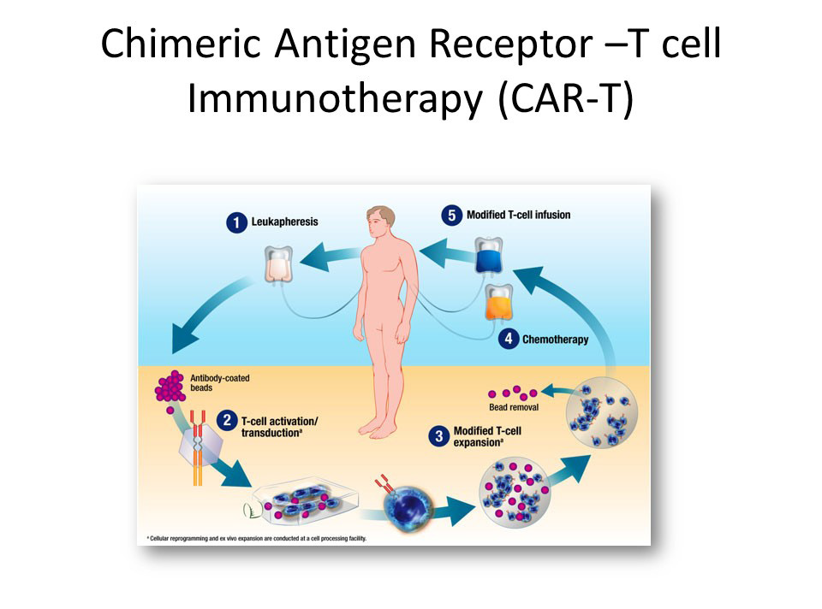

Slide 86
Treatment course
Asymptomatic
Symptomatic
Acute
MGUS
Stable MM
Pancytopenia
Plasma cell leukemia
M protein
Treatments
Years
Months
Days

Slide 87
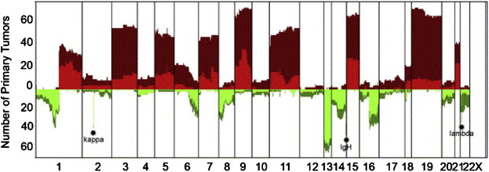
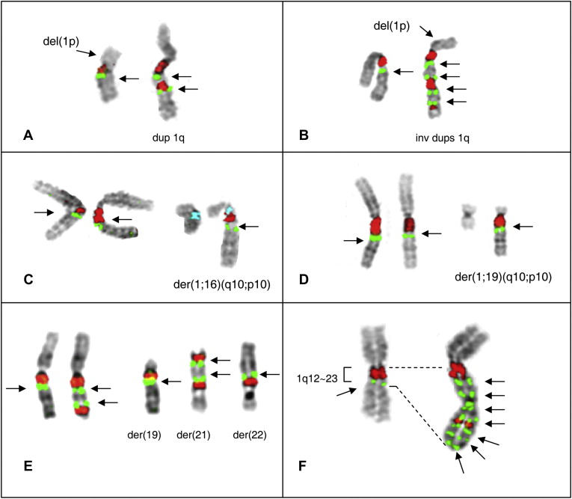
Cytogenetic Profiles of Myeloma
Carrasco et al Cancer Cell, Sawyer et al CGG, 2011

Slide 88
IMWG Molecular Classification of Myeloma
 | Percentage of patients | Clinical and laboratory features
Hyperdiploid | 45 | More favorable, IgG-κ, older patients.
Non-hyperdiploid | 40 | Aggressive, IgA-λ, younger individuals
Cyclin D translocation | 18
t(11;14)(q13;q32) | 16 | Upregulation of CCND1; favorable prognosis; bone lesions. Two subtypes by GEP; CD20+ in one subset
t(6;14q)(p21;32) | 2 | Probably same as CCND1
t(12;14)(p13;q32) | <1 | Rare
MMSET translocation | 15
t(4;14)(p16;q32) | 15 | Upregulation of MMSET; upregulation of FGFR3 in 75% unfavorable prognosis with conventional therapy; bone lesions less frequent
MAF translocation | 8 | Aggressive
t(14;16)(q32;q23) | 5 | Confirmed as aggressive by at least two series
t(14;20)(q32;q11) | 2 | One series shows more aggressive disease.
t(8;14)(q24;q32) | 1 | Unknown effect on outcome but presumed aggressive.
Unclassified (other) | 15 | Various subtypes and some with overlap
IMWG. Leukemia 2010

Slide 89
Factors Associated with Increased Disease Risk in MM
Gene expression profile (GEP) 70 (or GEP15) high risk signature
FISH:
  t(4:14); t(14:16)
  Del 17p
  1q amp; hypodiploidy
Abnormal cytogenetics by metaphase, including del chr 13
ISS Stage 3 (increased beta 2 m)
High LDH
> 10 focal lesions on MR

Slide 90
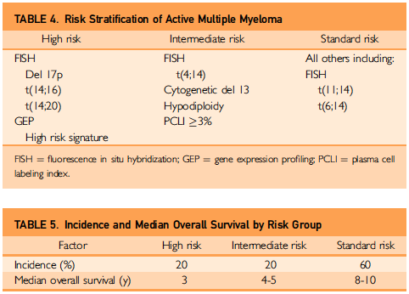
Mayo Clin Proc, Apr 2013

Slide 91
Initial therapy in myeloma
Current approach based on risk status and potential candidacy for stem cell transplantation.
Combination therapy superior to single agents.

Slide 92
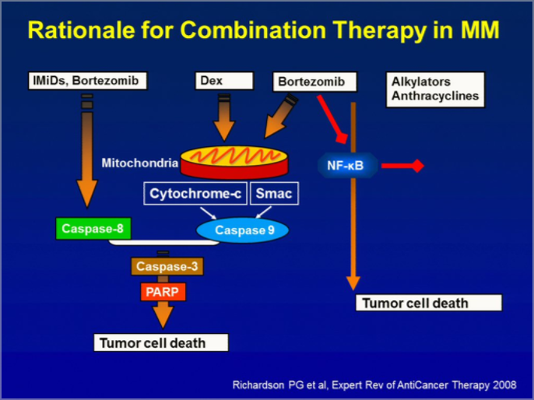

Slide 93
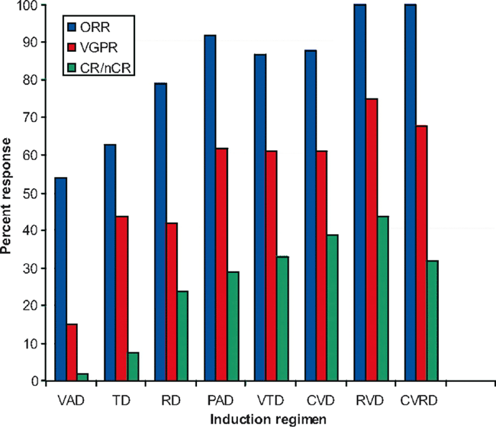
High Response Rates to Induction Therapies in MM
Notes:
Combinations in the Upfront Treatment of MM [Blood. Copyright 2009. Reproduced with permission of Blood in the format Journal via Copyright Clearance Center]. ORR, objective response rate; VGPR, very good partial response; CR, complete response; nCR, near CR; VAD, vincristine, adriamycin, dexamethasone; TD, thalidomide and dexamethasone; RD, lenalidomide and dexamethasone; PAD, bortezomib, doxorubicin, dexamethasone; VTD, bortezomib, thalidomide and dexamethasone; CVD, cyclophosphamide, velcade, dexamethasone; RVD, lenalidomide, bortezomib and dexamethasone; CVRD, bortezomib, dexamethasone, cyclophosphamide, lenalidomide.
© This slide is made available for non-commercial use only. Please note that permission may be required for re-use of images in which the copyright is owned by a third party.

Slide 94


Slide 95


Slide 96
High dose therapy in myeloma
Small randomized trials showing superiority to conventional therapy without ASCT (two with mature data).
Early ASCT not superior to late ASCT.
No conditioning regimen superior to melphalan alone.
No benefit from CD34+ selected grafts.
Superiority of SCT is being tested in the setting of new drugs.

Slide 97
Initial Therapy: Transplant Ineligible
Melphalan + Prednisone was once the standard approach.
RCTs show superiority of addition of thalidomide (MPT) or Velcade (MPV) to MP.
Lenalidomide and dexamethasone is also active.

Slide 98

The future…
JCO, 30(4), Feb 2012

Slide 99
Waldenström Macroglobulinemia
Uncontrolled proliferation of lymphoplasmacytes producing IgM
Median age 63 years
Presents with weakness, fatigue, epistaxis, blurred vision
Bone pain and lytic bone lesions are uncommon (<5%)
25% have hepatomegaly, splenomegaly and lymphadenopathy
Hyperviscosity is common

Slide 100

Mayo Clin Proc, Sept 2010

Slide 101
Hyperviscosity syndrome
bleeding (nasal and gums)
blurred vision
dizziness, headaches, ataxia
congestive heart failure
retinal vein engorgement, and papilledema
rarely occurs with serum viscosity <4 centipoises (cp) (normal 1.8 cp)
IgM pentamer

Slide 102
Macroglobulinemia: Principles of Therapy
Observation in patients with asymptomatic disease.
Active drugs for therapy
  Alkylating agents: Chlorambucil, Cytoxan
  MAbs: Rituxan
  Purine analogues: Fludarabine, Cladribine
  Bendamustine
  Steroids
  Bortezomib
  Thalidomide analogues

Slide 103

Plasma Cell Disorders Manifest Due to Clonal Immunoglobulin
AL Amyloid
Light chain deposition dz
Neuropathy
Cryoglobulinemia
Acquired vWD

Slide 104
Clinical Settings Where Ig Deposition Diseases (Including AL Amyloid) Should Be Suspected In Pts With Monoclonal Ig
Congestive Heart Failure
Neuropathy (including autonomic neuropathy)
Nephrotic syndrome, Renal Failure
Malabsorption
Hepatosplenomegaly
Carpal tunnel syndrome
Macroglossia
Unexplained constitutional symptoms

Slide 105

Diagnostic Approach in Suspected AL Amyloid

Slide 106
Principles of Management in AL Amyloid
Therapeutic approach guided by age, organ involvement.
Cardiac involvement and dysfunction as a major predictor.
Therapy directed at the underlying clonal plasma cells.
  Melphalan
  Steroids
  Proteasome Inhibitors (Velcade)
  Thalidomide/lenalidomide

Slide 107
Conclusion
Plasma cell dyscrasias are a heterogeneous group of disorders.
Clinical presentation may be due to the clone itself or the properties of the secreted Ig.
Therapy largely directed (if indicated) at reducing the underlying clone.

